Slide 1
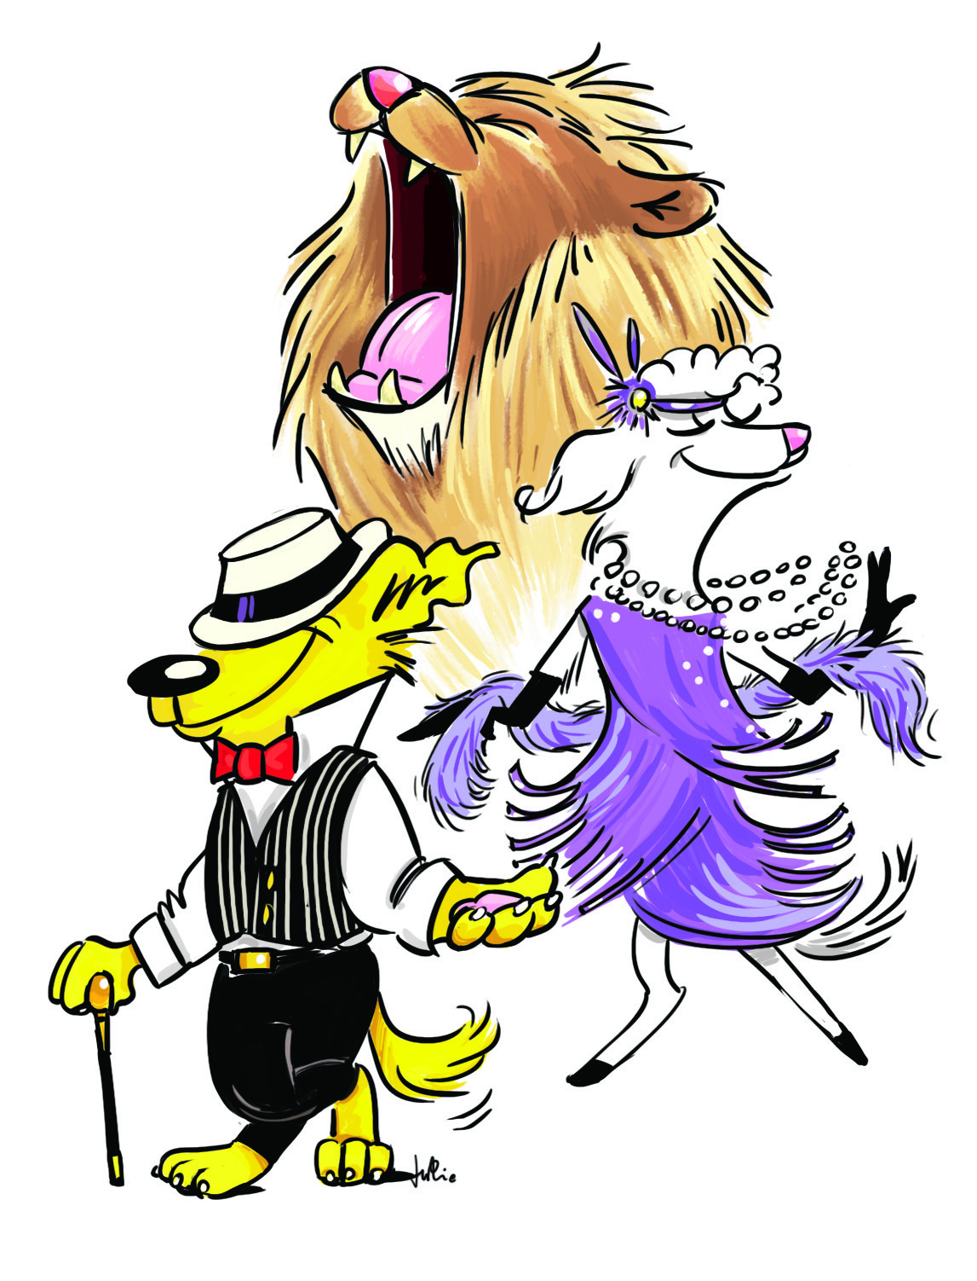
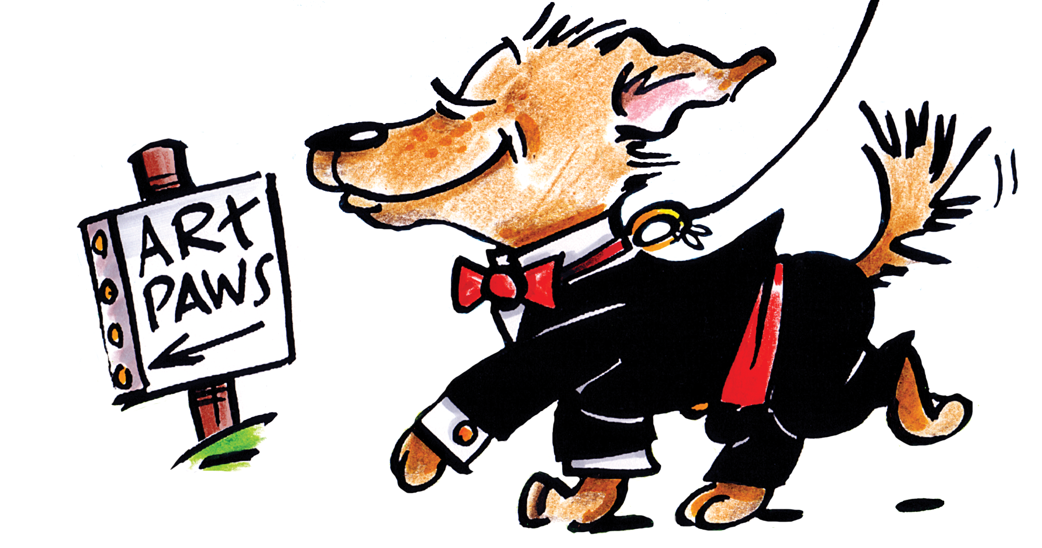
Art Paws 2020 Sponsors
Check out the amazing artist, crafters and animal related businesses who attend Art Paws. Shop virtually and join us for our live event Sunday July 19th 2020, 11am-2pm.
www.ArtPawsReno.com

Slide 2
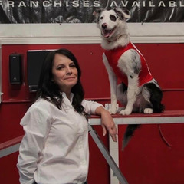
Sit Means Sit
Life with your pup should be a walk in the park, not a struggle to stay on the path. After all, a happy dog owner has a trained dog -- and a happy dog is trained! That's why SIT MEANS SIT dog training offers a unique approach that focuses on communication through attention. We'll customize a program with sessions designed to stimulate your dog's mind, body, and spirit. All this means faster results, a better-behaved dog, and more enjoyable time with your canine family member.
11:05am - Session 1 Ask the Trainer: Q and A
12:20pm - Session 2 Walk the Dog: Teaching dogs leash skills
1:10pm - Session 3 Live Training Demonstrations
Demo times are approximate. Variable due to attendee participation!

Slide 3
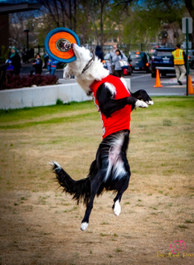
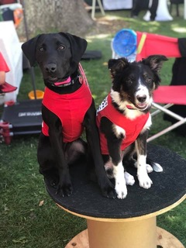
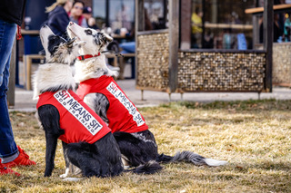
Sit Means Sit

Slide 4
Healthy Tails
Mayberry Landing
(775) 787-3647
3892 Mayberry Dr #B, Reno, NV 89519
South Creek
(775) 851-2287
55 Foothill Rd #3, Reno, NV 89511
Our Philosophy
We're here to help you and your pets!
To talk to our pet specialist call;
(775) 787-3647 or (775) 851-2287

Slide 5
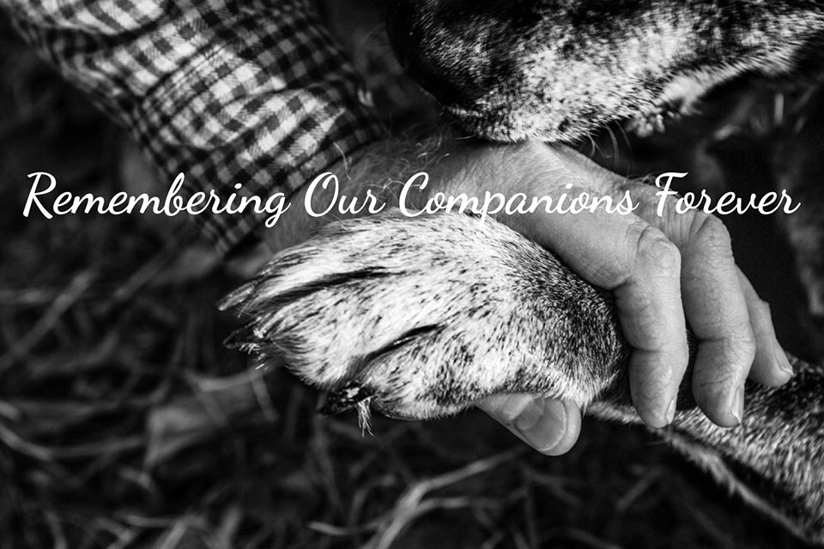
Hearts Companion
Heart's Companion is more than just a Pet Memorial Center. We believe in being involved in the life of your pet before our services are needed. We care deeply for our own pets and feel they deserve an incredible life full of fun things to do and lots of love.
We are honored to be a part of the local community and to share in celebrating the specific benefits that pet ownership can bring. As our way of giving back to the Reno area, we sponsor non-profit pet events, participate in adoption drives, are members of the historic downtown merchants group, work with local pet stores to promote local community events, and provide free cremation services to local service animals to honor them for their life of service to the community as our way of saying, “Thank you, and a job well done.”
Our facility is a fully renovated home, located in historic downtown Reno, where the tranquility of the Truckee River can bring peace to a troubled mind and heart. All of our services are performed on our premises with state of the art, modern equipment.
Our purpose is to provide your special animal with gentle, reverent aftercare, and support you through the difficult process of losing your heart's companion.
119 Bell St
Reno, Nevada

Slide 6
Reno Lithia Subaru
Lithia Reno Subaru
2270 Kietzke Ln
Reno, NV 89502

Slide 7
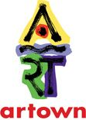

Slide 8
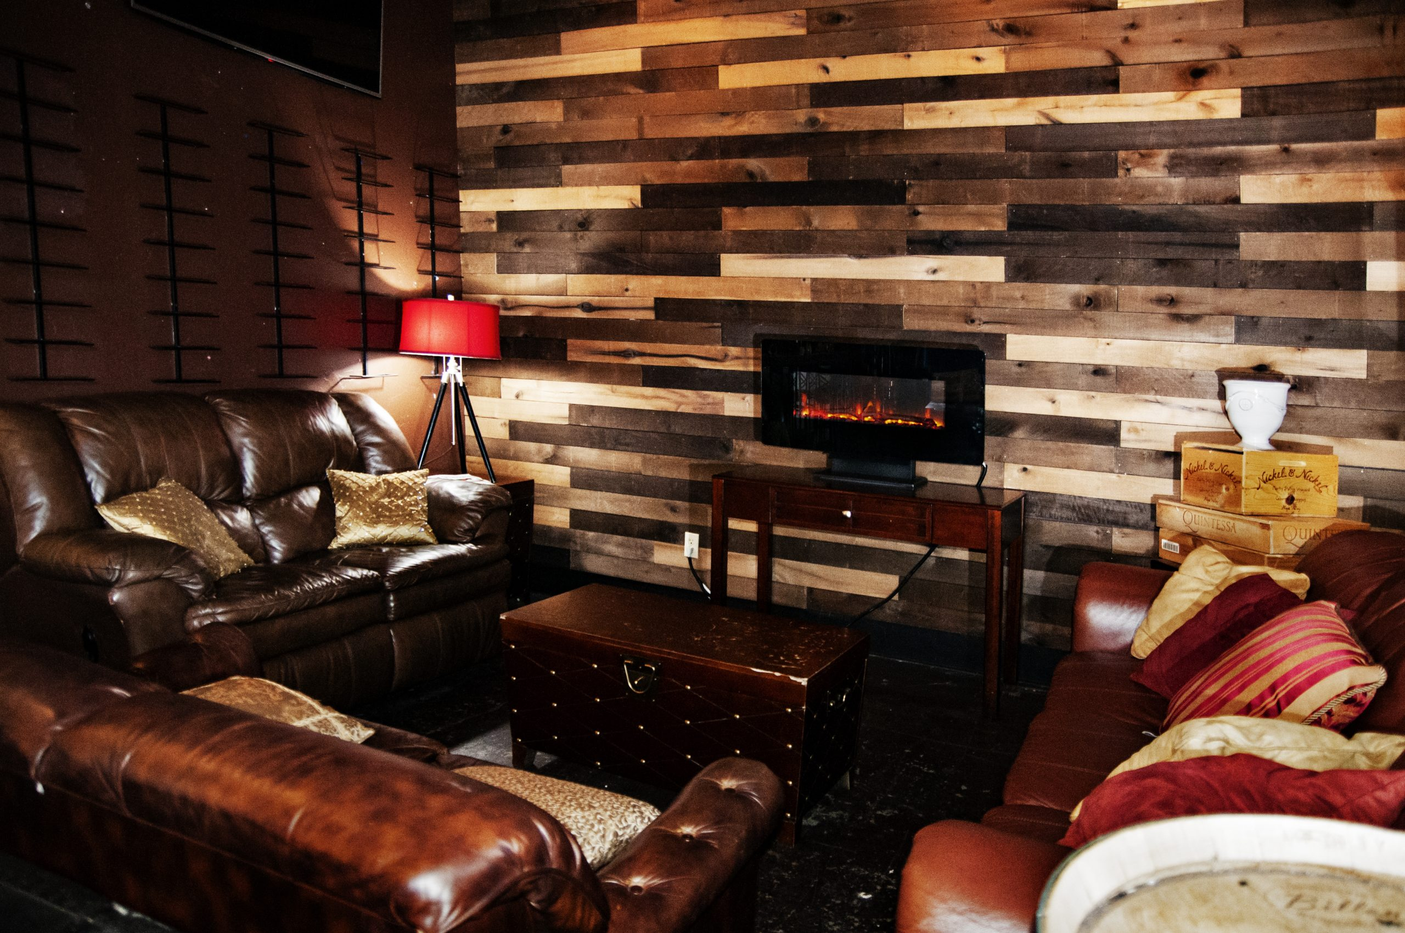
Midtown Wine Bar
1527 South Virginia Street
Reno, NV 89502
In the Midtown District of Reno, Nevada
Hours
Wednesday - Friday: 3:00pm - Close
Saturday: 1:00pm - Close
Sunday - Tuesday: CLOSED
https://midtownwinebarreno.com/
Located in the beating heart of Reno’s Midtown District, MidTown Wine Bar is not your typical wine bar. Nightly events, live music, games, and happy hours every day will keep you coming back. With a full menu of craft beers and local wines and a fun inviting atmosphere, MidTown Wine Bar is Reno’s number one after work and weekend hang out spot. And take a gander at all the amazing local artwork that beautifies the walls here at MidTown Wine Bar. See you soon!

Slide 9
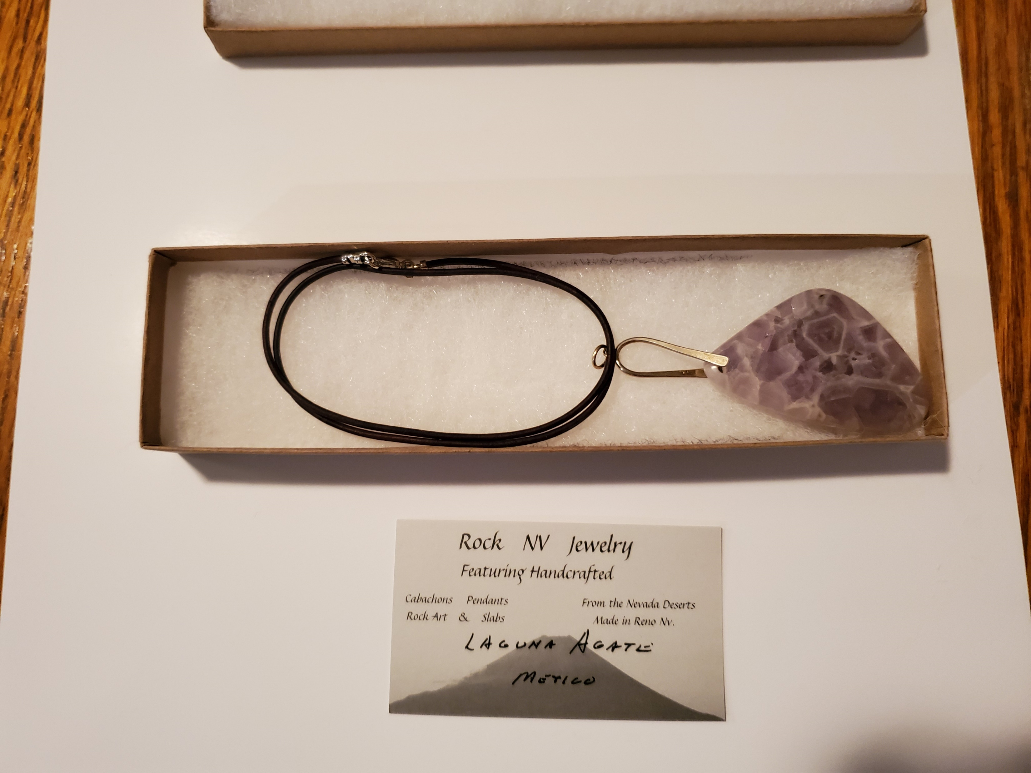
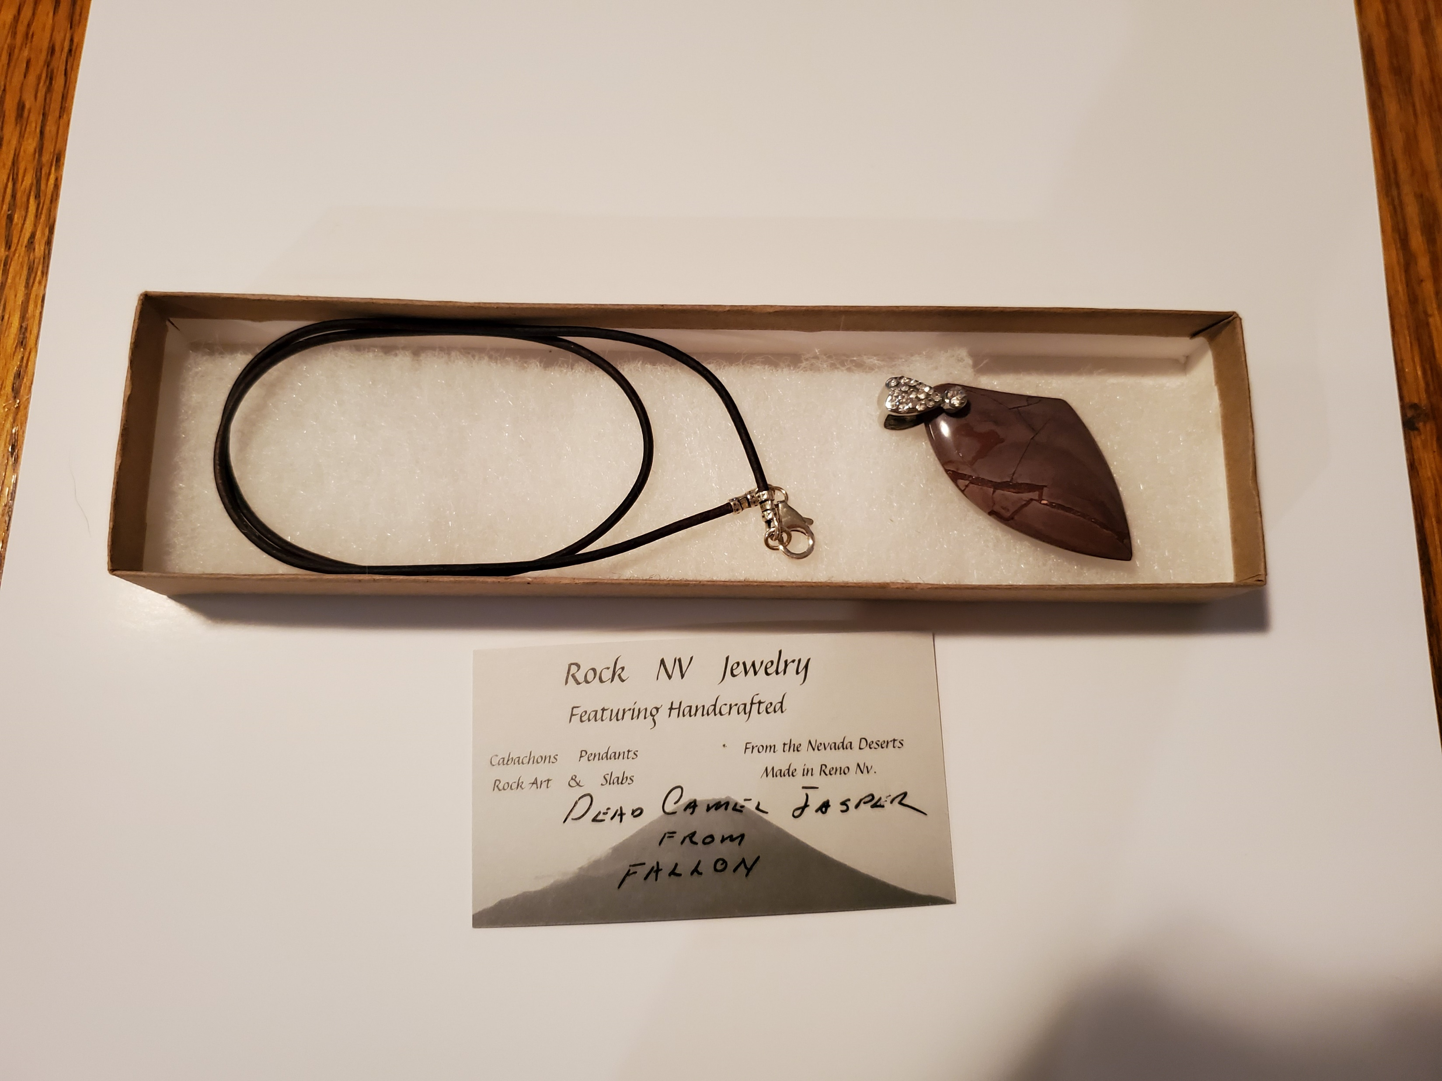
Rock NV Jewelry
We collect rocks from Nevada and the Southwest and personally turn them into beautiful jewelry.
I make and sell stone slabs, cabochons, specimens and fine jewelry. Totally unique creations.
abcmetz@gmail.com
http://ETSY.com/shop/rocknvjewelry

Slide 10
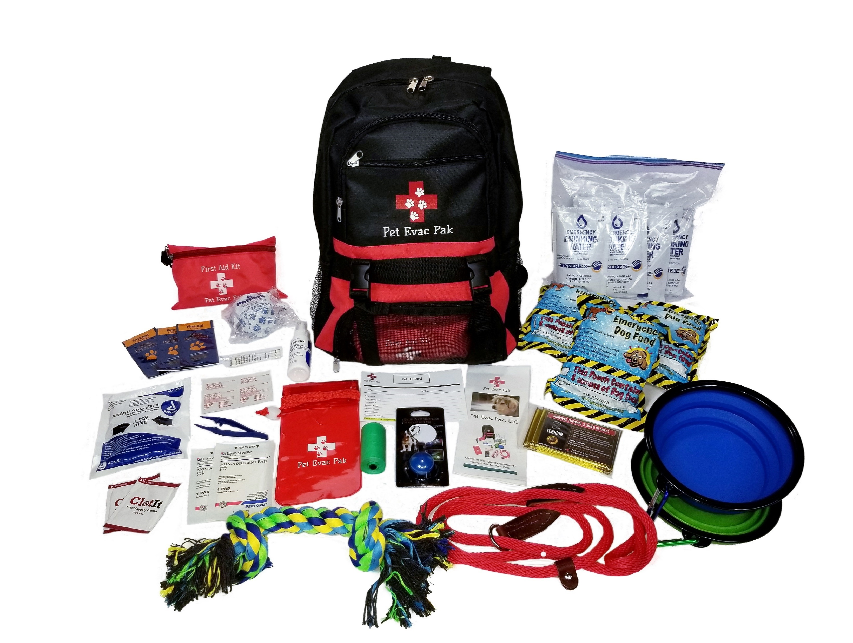
Pet Evac Pak
Pet Emergency Preparedness….
Claudia Wiles and Michelle Danielson are Co-founders of Pet Evac Pak LLC based in Reno NV. They provide Emergency Evacuation Kits for pets. Claudia a former Marine and Michelle a former Farm Store buyer, formed this company after a trip Michelle took to Houston after Hurricane Harvey. They discovered that people were just not prepared to evacuate with their pets. The Campfire in Paradise California was another good example.
​If you are like millions of pet owners nationwide, they are an important member of your household. The likelihood that you and your animals will survive an emergency such as a fire, earthquake, flood, tornado or terrorist attack depends largely on emergency planning done today. We will cover how to make-a-plan and what to put in your pet's go-bag should you need to evacuate. Also a little on what to expect during the pandemic.
Keep in mind that what’s best for you is typically what’s best for your animals.
Click HERE to purchase!
Check out Pet Evac Pack on YouTube!

Slide 11
Valentine Family Insurance
We are a family run agency. We are your Risk Advisors. We don’t sell insurance...we identify everyday risks to help you and your family transfer those risks to protect your current and future assets. Set an appointment with us today!
4792 Caughlin Parkway Suite 204
Reno, Nevada
(775) 348-6393
kvalentine@farmersagent.com

Slide 12
Valentine Family Insurance
Valentine Family Insurance will donate $1.00 to Art Paws Inc. for each qualified insurance quote given for Art Paws attendees. Click HERE for your quote.
*Qualified quotes include all of the following information:
Full legal name and Date of Birth for any household drivers
Address including city, state and zip
Phone Number
Email Address
4792 Caughlin Parkway Suite 204
Reno, Nevada
(775) 348-6393
kvalentine@farmersagent.com

Slide 14
Aaron Bushur for Family Court Judge

Slide 15
Art Paws 2020 Benefits:

